Slide 1
Hokkien

Slide 2
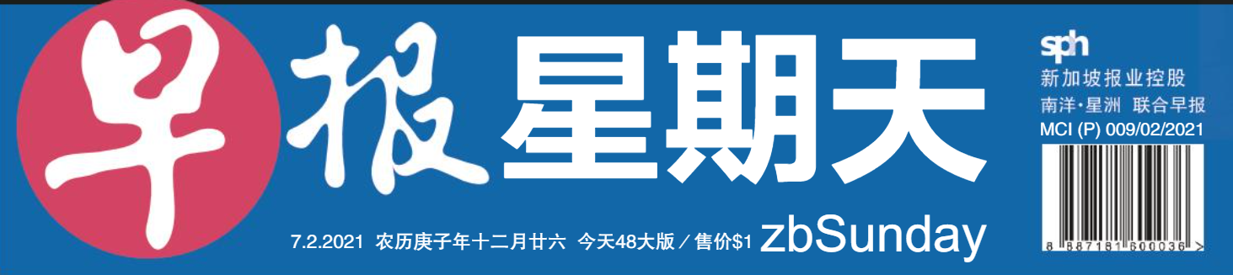
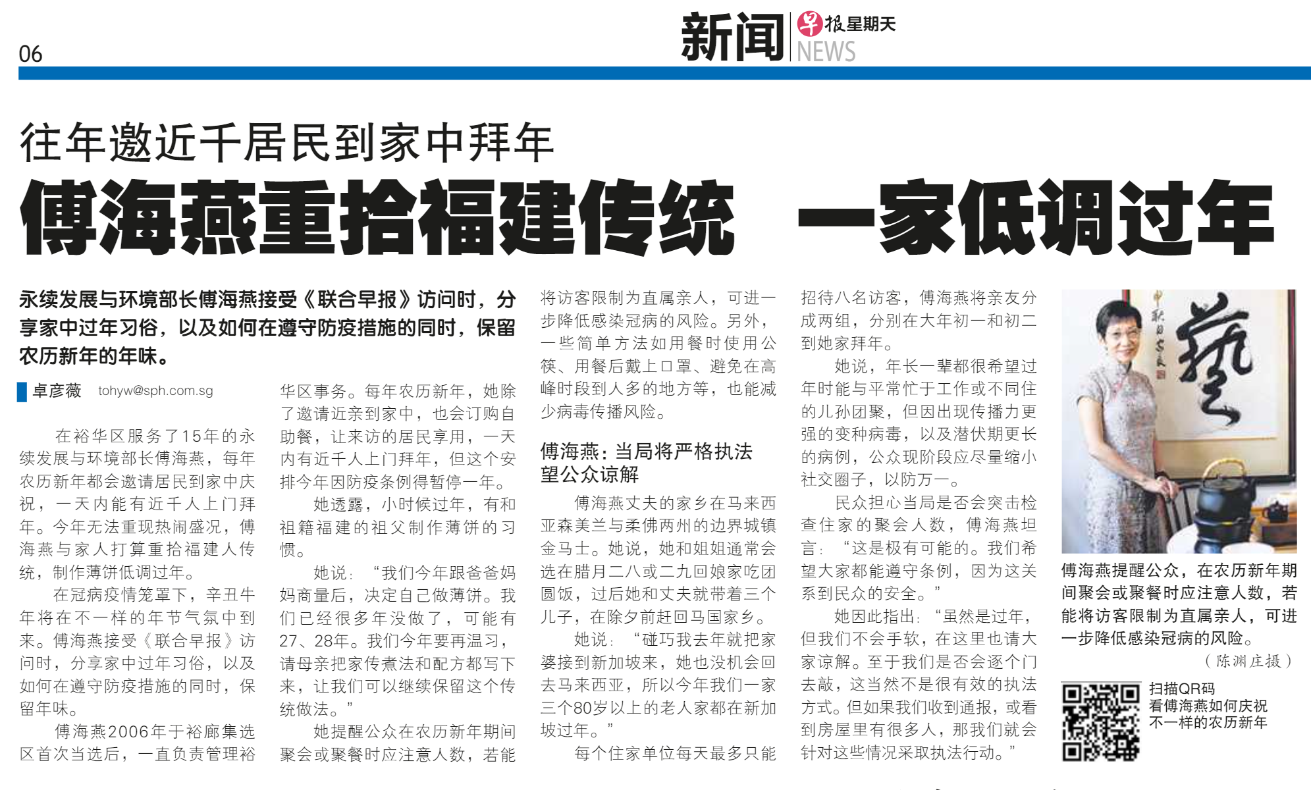
Grace Fu to have a low-key CNY by returning to her Hokkien roots
Making of Popiah

Slide 3
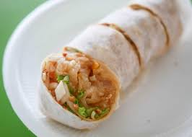
Popiah

Slide 4
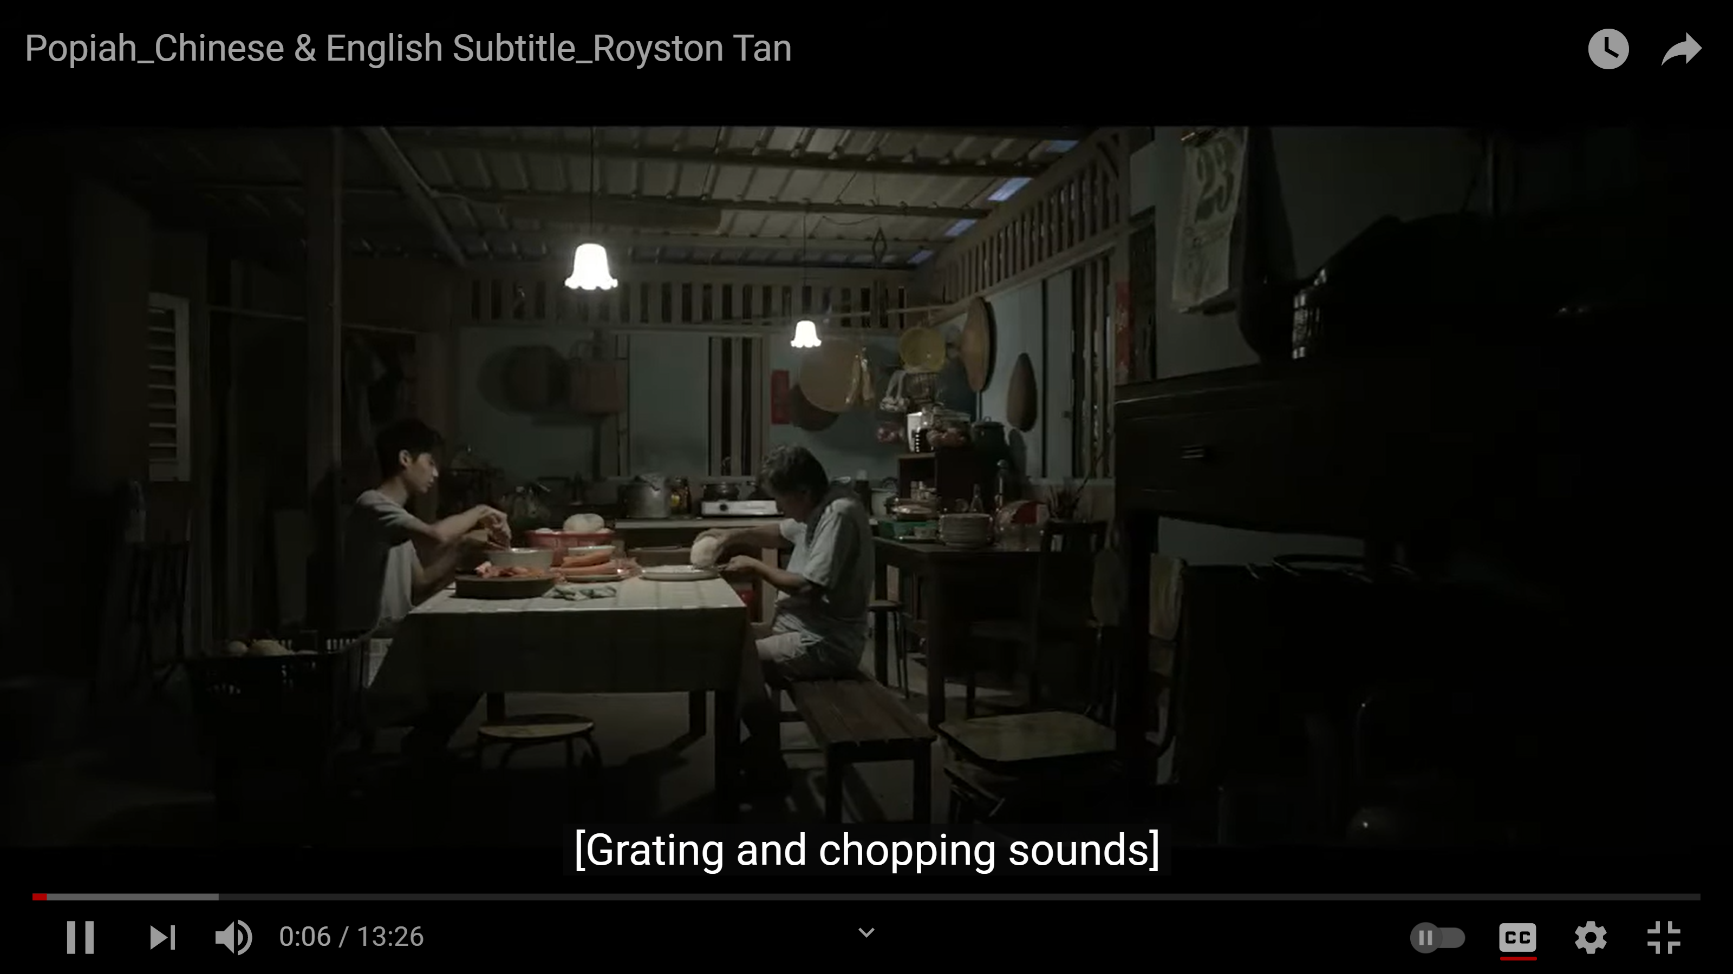
A community film presented by KMSPKS that emphasises gratitude for the quiet love of our own families. Written & Directed by Royston Tan.
Kong Meng San Phor Kark See Monastery

Slide 5
Please watch this short film as we will be talking about it in lectures 10 & 11.
https://www.youtube.com/watch?v=VQDDA4KaE6k&t=12s

Slide 6
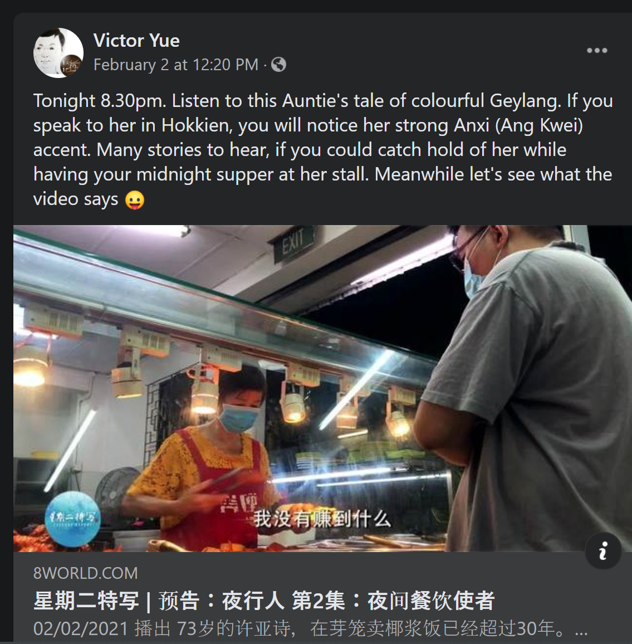
Royston Tan is the narrator for this episode. Why Royston Tan? And why Baey Yam Keng for the episode on the Teochew “fish-rice”?
Tuesday Report : Through the Nights (on Channel 8 every Tuesday at 2030 pm）

Slide 7
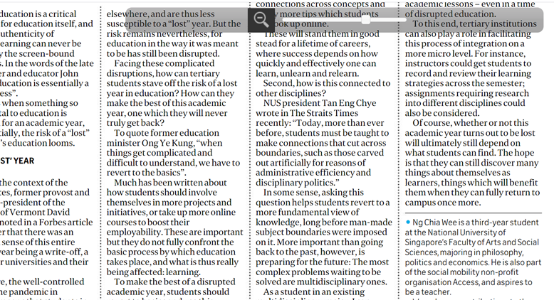

Slide 8
Former Director (Corporate Communications & Go East) of non- profit organisation Business China.
Singapore Chinese Chamber of Commerce & Industry

Slide 9
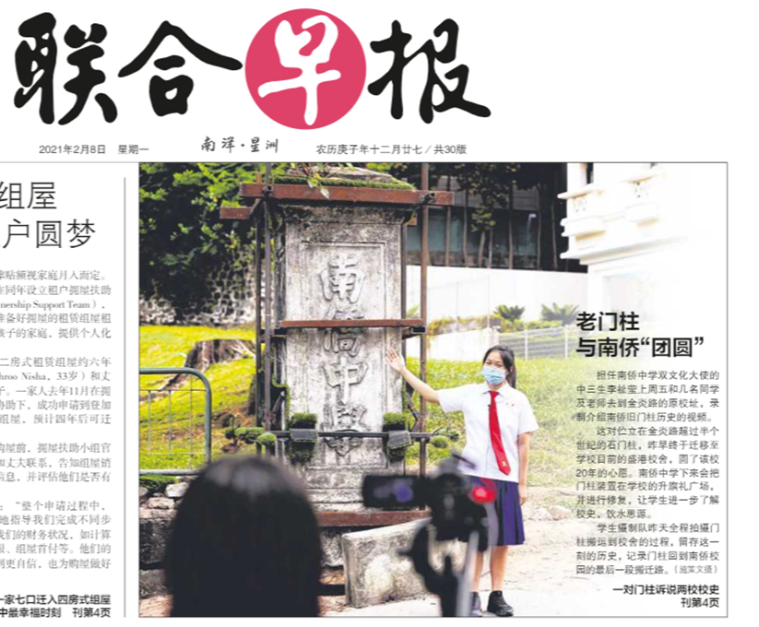
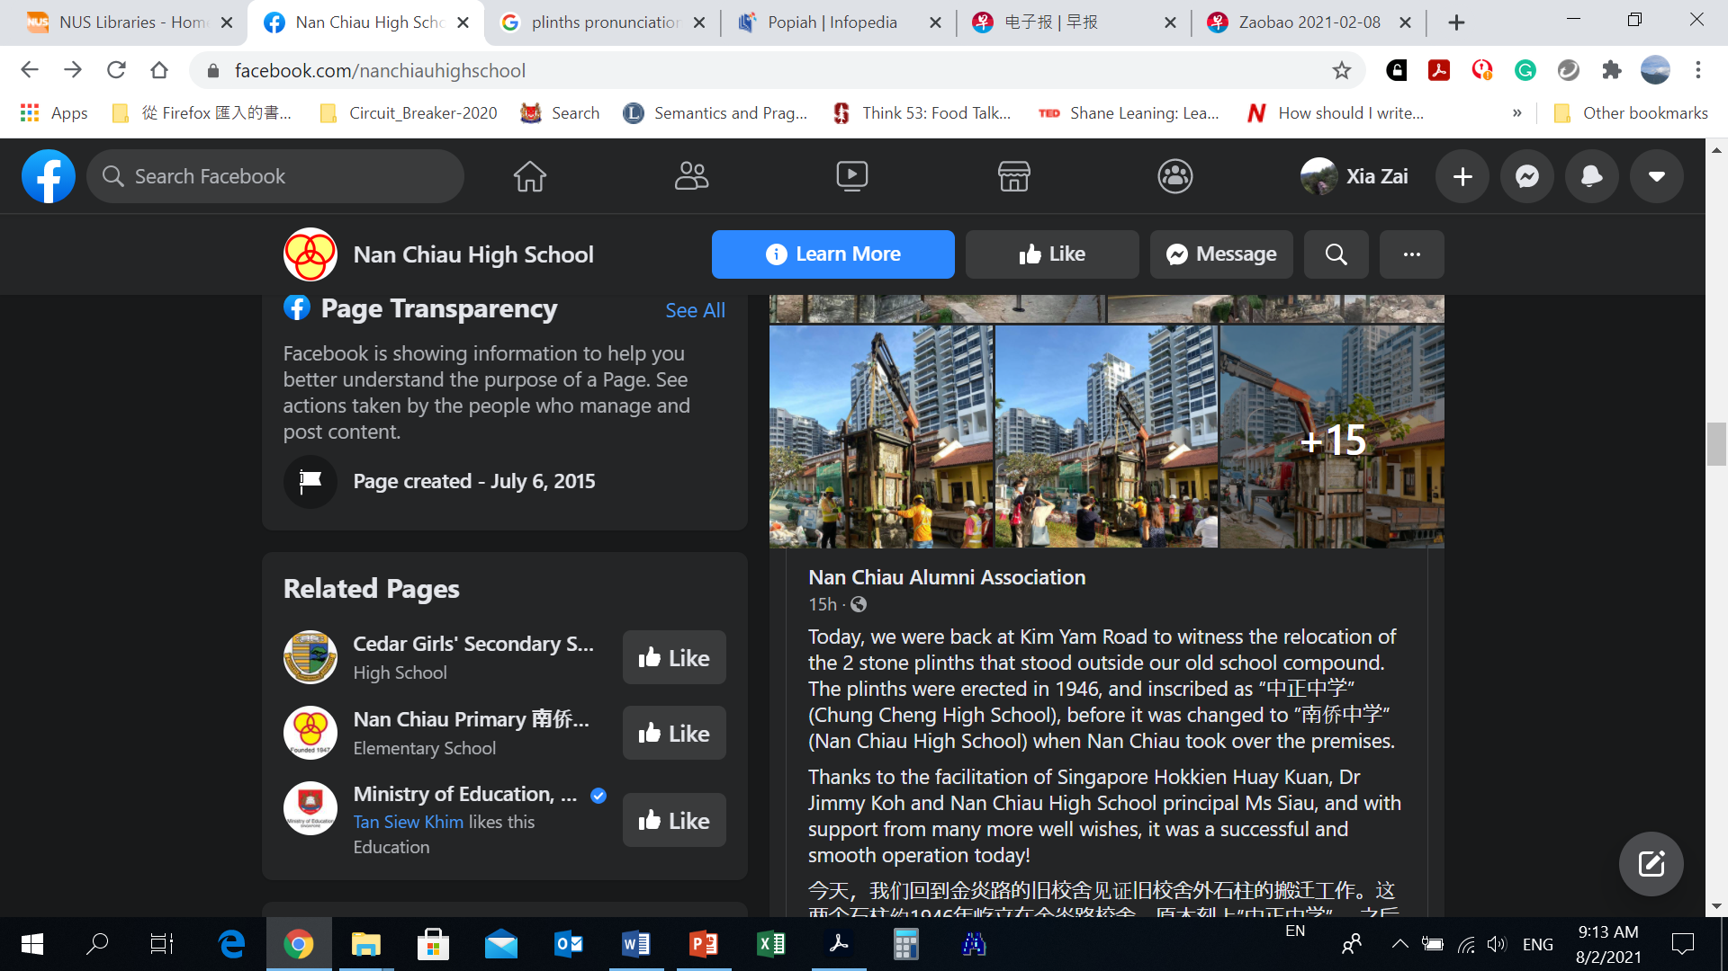

Slide 10
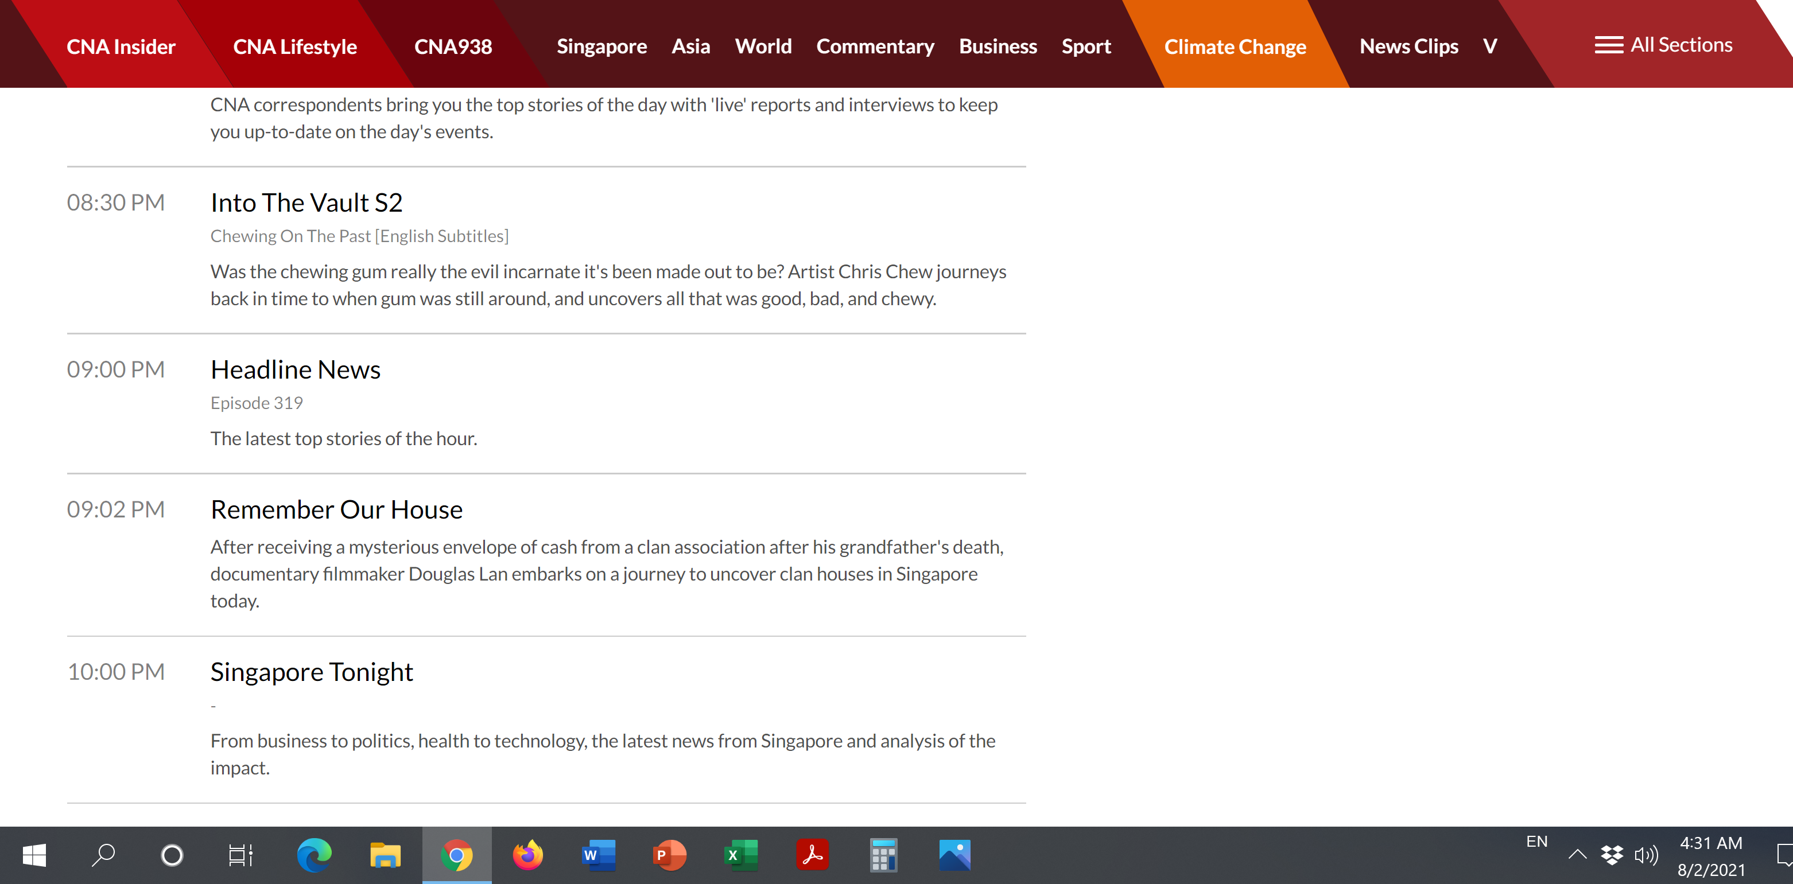
A documentary on clan association this coming Friday on CNA.

Slide 11
Cantonese

Slide 12
